Slide 1

Quant Week 1
09/11/25
Notes:
Complete

Slide 2

Ice Breaker
What has been the worst class you have taken so far?

Slide 3
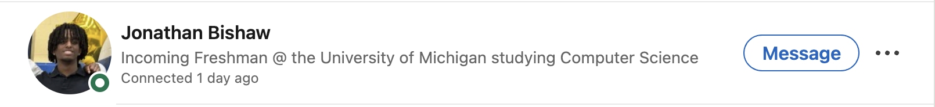
Shout out to Jonathan Bishaw!
https://www.linkedin.com/in/jamwevan/

Slide 4
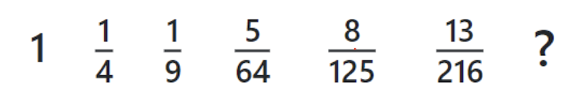
Sequence (Hard)

Slide 5
What is “Quant”?

Slide 6
Quantitative Finance Overview
Within quantitative finance there are a variety of interesting areas and problems to solve
Different asset types
Different roles
Tons of data
Engineering challenges, like trade execution and speed
and massive implications

Slide 7

Asset Classes
Stocks (GME, AMC, TSLA)
Derivatives/Options
Foreign Exchange (Forex)
Crypto
Sports Betting
Key: high volatility (opportunity + volume)

Slide 8
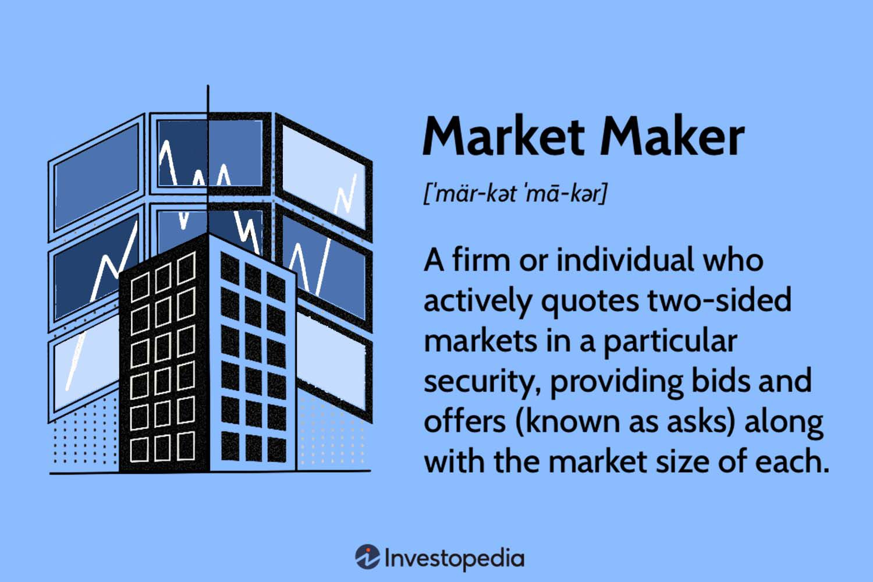
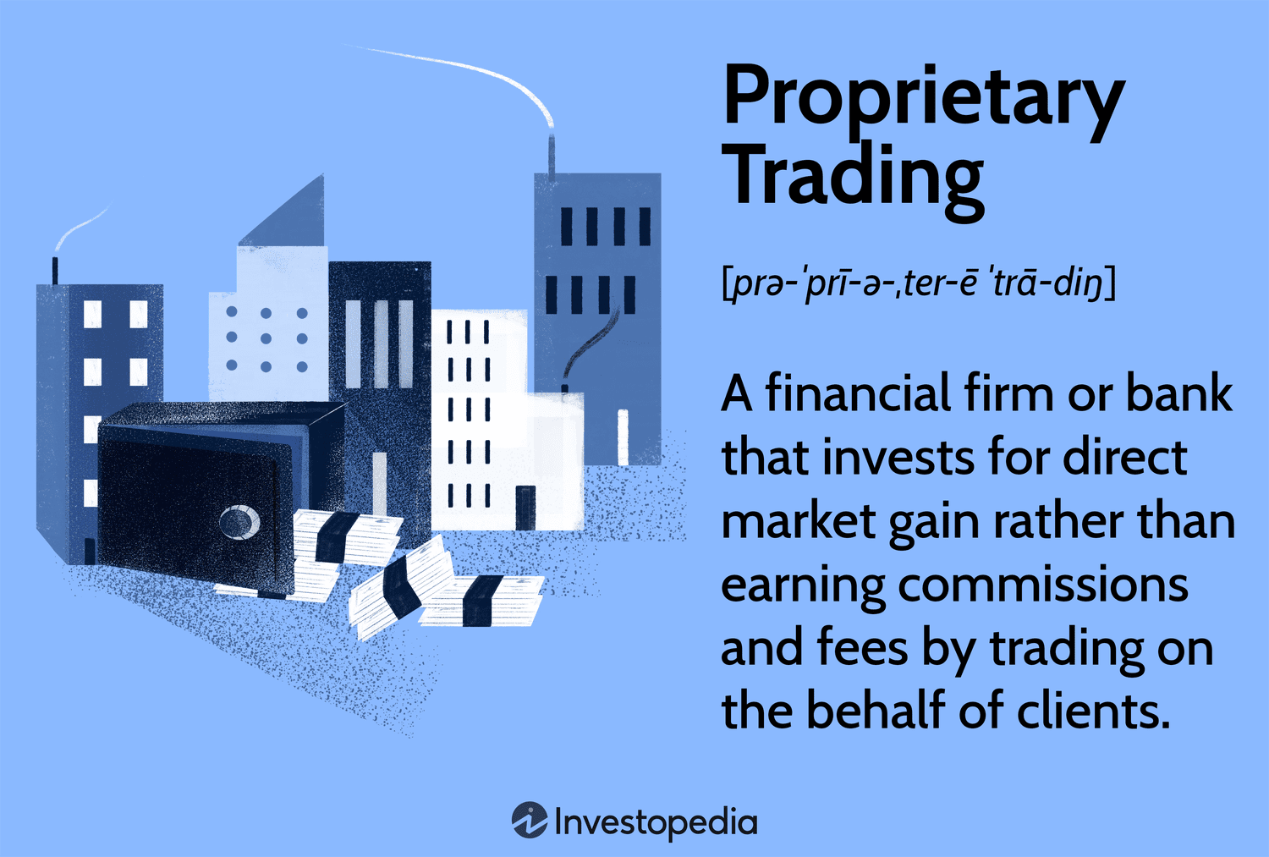
Industry
Market Makers:
Goldman Sachs, Jane Street Capital, SIG
Prop Trading Firms / HFTs:
Citadel, Optiver, IMC, DRW, Virtu, CTC

Slide 9
Roles in Quant

Slide 10
Roles in Quantitative Finance
Quantitative Traders
Execute trades
Teams divided based on asset class and other factors
Act as a manager to automated trading systems
Change parameters
Respond to the market
Analyze and improve decision making process in post-trade analysis
Much of young traders’ time is spent shadowing other traders and developing what’s referred to as “traders’ intuition”

Slide 11
Roles in Quantitative Finance
Software Engineers
Similar to their big tech counterparts
Manage infrastructure
Deal with scalability
Optimize trading algorithms for speed and efficiency
Low latency programming
FPGAs
Generally working as a SWE in a quant firm is similar to working as a SWE anywhere else, but with higher stakes and an emphasis on efficient system design and speed.

Slide 12
Roles in Quantitative Finance
Quantitative Researchers
Work has aspects of both traders and engineers
Analyze trades
Use statistical inference and data analysis
Develops algorithms at a higher level which will be optimized later
Highly secretive and highly paid
Researchers generally have advanced degrees
(PhD and less frequently MS)

Slide 13
What is an Order Book?

Slide 14
Order Book
A visual representation of current limit orders
Limit orders: Orders placed to buy or sell at a specific, predetermined price
Market orders: Orders placed to buy at the current available price
Understanding an order book is very important for working in quant (and as a result, interviewing for quant)
The order book is a key component of understanding how market makers make money

Slide 15
Order Book Example
Bid (Volume) | Price | Ask (Volume)
 | 100.03 | 150
 | 100.02 | 100
 | 100.01 | 50
 | 100
60 | 99.99
120 | 99.98
180 | 99.97

Slide 16
Order Book Example
Bid (Volume) | Price | Ask (Volume)
 | 100.03 | 150
 | 100.02 | 100 (SOLD)
 | 100.01 | 50 (SOLD)
 | 100
60 | 99.99
120 | 99.98
180 | 99.97

Slide 17
Order Book Example
Bid (Volume) | Price | Ask (Volume)
 | 100.05 | 250
 | 100.04 | 200
 | 100.03 | 150
 | 100.02
60 | 100.01
120 | 100.00
180 | 99.99

Slide 18
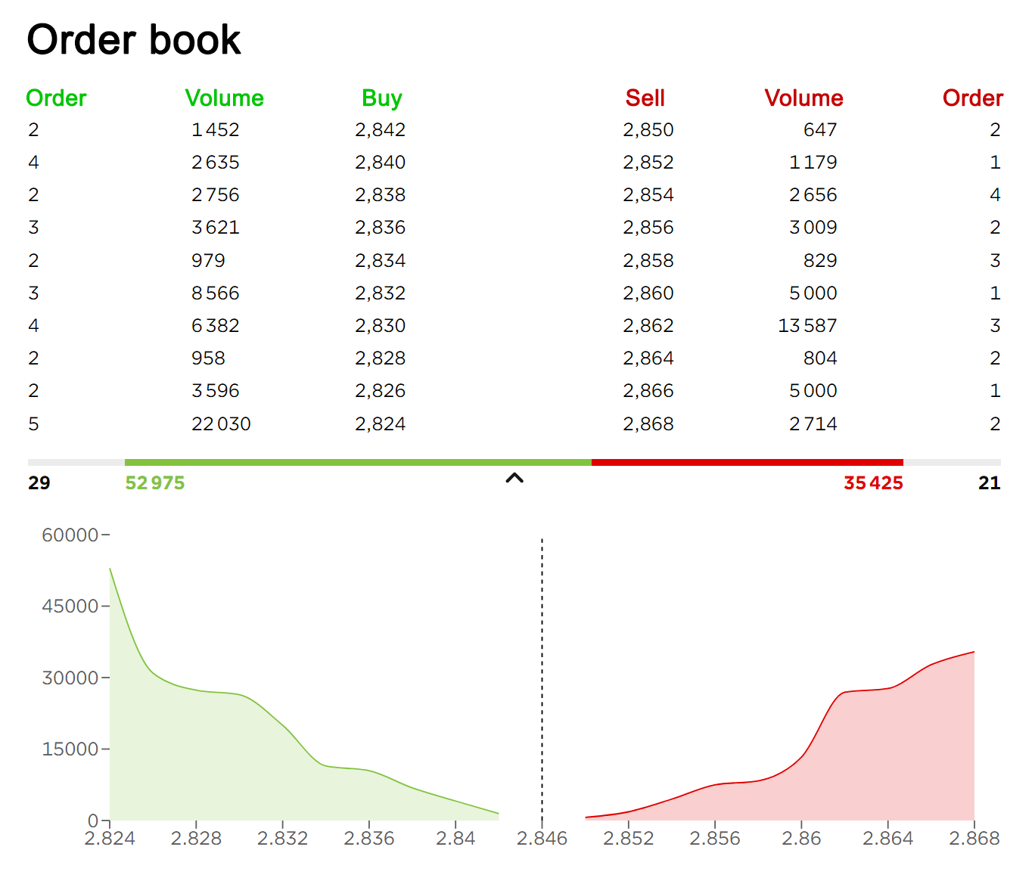
Order Book Example

Slide 19
Market Making

Slide 20
What is Market Making?
In the general sense, a market is a place where you can both buy and sell assets (food, clothing, financial assets, illegal goods, etc.).
Any person who buys or sells a given asset might be a component of a market, but is not considered a market maker. The key feature of a market maker is that they quote both a buy and sell price for an asset.
Some of the more well known market makers are:
Citadel Securities
Jane Street
Virtu Financial
Many large banks (Goldman Sachs, Morgan Stanley)

Slide 21
How do MMs make money?
The goal of a market maker is to quote bid and ask prices such that people buy and sell equal amounts of the asset on both sides.
From the order book example earlier, if there are no large orders, and market orders are trickling in, whoever is making that market makes $0.02 for every pair of offsetting trades.
An interesting feature of this strategy is that market makers remain neutral to moves up or down in the market. As long as their quoted prices result in equal amounts of trading on either side, they profit, regardless of large swings in the market.

Slide 22
High Frequency Trading

Slide 23
What is HFT?
The practice of trading at incredibly high speeds
Driven by highly efficient algorithms written in low level languages or on FPGAs
Requires significant infrastructure and investment
Generally profit per trade is incredibly low, but the sheer volume of trades results in large profits
HFTs are incredibly secretive about their strategies. As soon as another firm discovers their strategy, the pseudo-arbitrage opportunity closes, and it is generally no longer profitable.
As a result, many employees are required to sign NDAs and long non-competes (2+ years).

Slide 24
Basic HFT Strategies

Slide 25
Arbitrage
Arbitrage describes an opportunity in which an individual can buy an asset, and immediately sell it for a higher price.
The most common example is in ForEx markets, but it can also occur between exchanges.
Because of the competition present, these opportunities rarely exist, and are closed quickly when they do.

Slide 26
Latency Arbitrage
Latency Arbitrage is the most pure example of HFTs’ advantage over other traders/investors.
Suppose a hedge fund needs to buy a large chunk of a stock, and there isn’t enough liquidity in the order book
A HFT firm sees the hedge fund buying up all of this stock (in the form of rapid price movements) and starts to buy all of the stock on other exchanges
As a result, the hedge fund now has to pay a higher price, and the difference is the HFT firm’s profit

Slide 27
Event Arbitrage
Event arbitrage is when a HFT makes use of its speed to react to news stories faster than other players in the market
This results in significantly higher oil costs
An HFT firm might see this and be able to react far more quickly than other players
For example in Trump’s Inauguration speech last week: every sentence he said had the power to impact stock prices

Slide 28
Statistical Arbitrage
Essentially a more complicated version of pairs trading
Firms look at correlation between assets, and use highly technical models to bet on the convergence or divergence of certain assets or indicators
Generally more common nowadays

Slide 29
Project Discussion/Work Time
Notes:
Idea:
We’ll write the platform to make and conduct trading strategies.
You guys will write and implement the strategies, test them on prior data
Alternate for more software-oriented people you guys could also make the platform
We can do this in python/C++, if python use numPy and Yahoo Finance data
Use matplotlib plot graphs, show that in pdf/md/html file through github

